Slide 1
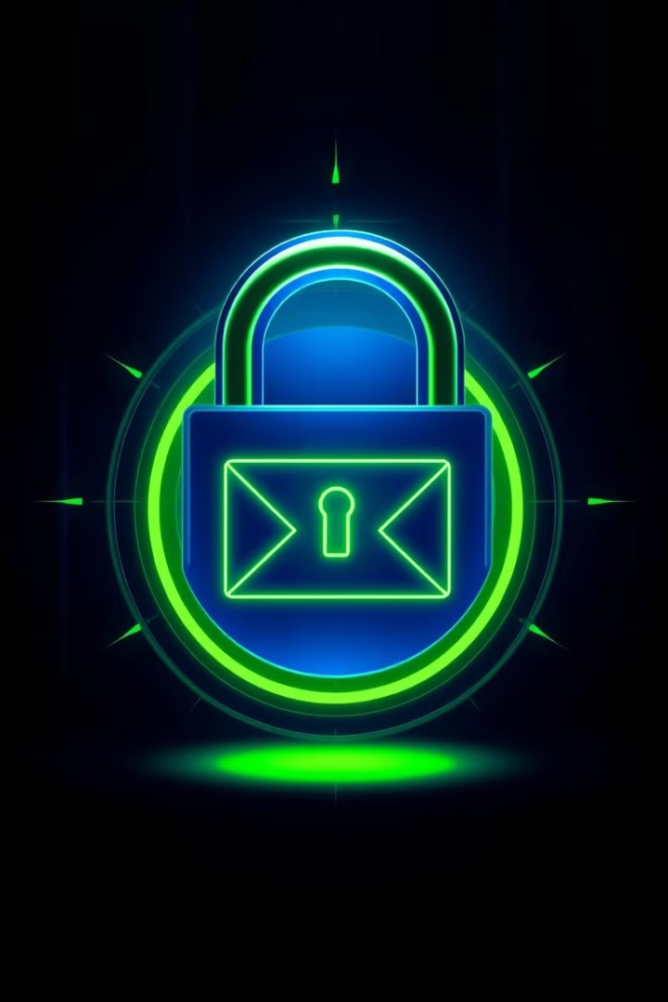
Email Security Framework for Corporate Communication Using S/MIME and Spam Detection
SRIRAAGAVI D.K
INBA PRANAOU I.V
pp

Slide 2
CRYPTOGRAPHY
Email Authentication: Cryptographic techniques underpin protocols like SPF, DKIM, and DMARC, which verify the legitimacy of email senders and detect forged addresses, thereby preventing email spoofing and phishing attacks Natural Language Processing (NLP):Spam Detection: NLP algorithms analyze email content to identify patterns and features indicative of spam. Techniques like Naive Bayes classifiers assess the probability that an email is spam based on its textual content. WIKIPEDIA Phishing Detection: Advanced NLP models, including transformer-based architectures, evaluate the semantics and context of email text to detect deceptive language commonly used in phishing attempts.

Slide 3
Abstract
Challenge
Solution
This framework leverages S/MIME for email encryption and spam detection algorithms to mitigate these threats, ensuring secure and reliable communication.
User Awareness and Behavior:
Human errors, such as clicking malicious links or weak password practices, remain a significant vulnerability.
Phishing and spam pose significant threats to corporate communications. Unsecured emails expose sensitive data and disrupt business operations.
Key aspects of email security include encryption, spam filtering, phishing detection, malware prevention, and user awareness.

Slide 4

Existing Technology
Traditional Email
Basic Spam Filters
Traditional email systems, designed for simplicity and communication, lacked inherent security mechanisms. The early email protocols, such as SMTP (Simple Mail Transfer Protocol), POP3 (Post Office Protocol 3), and IMAP (Internet Message Access Protocol), focused on delivering and managing emails but did not account for modern threats like spoofing, phishing, or interception.
Basic spam filters are designed to identify and block unsolicited, bulk, or malicious emails from reaching a user's inbox. These filters use simple rule-based or statistical methods to evaluate emails based on content, sender information, and other characteristics. While they provide foundational protection, their capabilities are limited compared to advanced filtering systems.

Slide 5
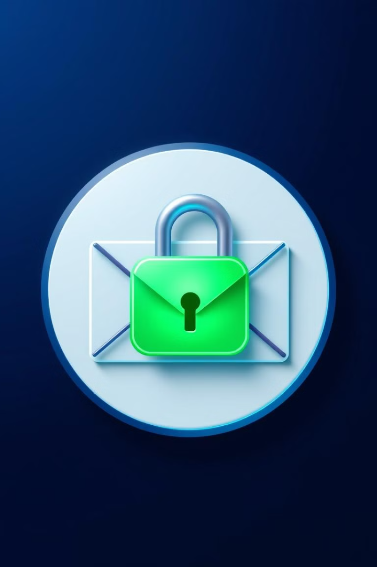


Proposed Technology
S/MIME Encryption
AI-Powered Spam Detection
S/MIME ensures secure email transmission by encrypting the message content and verifying the sender's identity.
Advanced spam detection algorithms analyze email content and sender behavior to identify and block malicious messages.

Slide 6



Output
Increased Security
1
Protection against data breaches and phishing attacks.
Improved Trust
2
Enhanced confidence in internal and external communications.
Enhanced Productivity
3
Reduced time spent managing spam and security threats.

Slide 7

Future Enhancement
1
Integration with other security platforms for a comprehensive approach.
2
Implementation of advanced threat intelligence and machine learning algorithms for continuous improvement.
3
Development of user-friendly tools for managing encryption certificates and reporting security incidents.

Slide 8

Conclusion
By implementing this robust email security framework, organizations can safeguard their communication channels, enhance data privacy, and build a culture of trust and accountability.

